Slide 1
AI PROJECT PLAN 2026
Prepared by : Jun

Slide 2
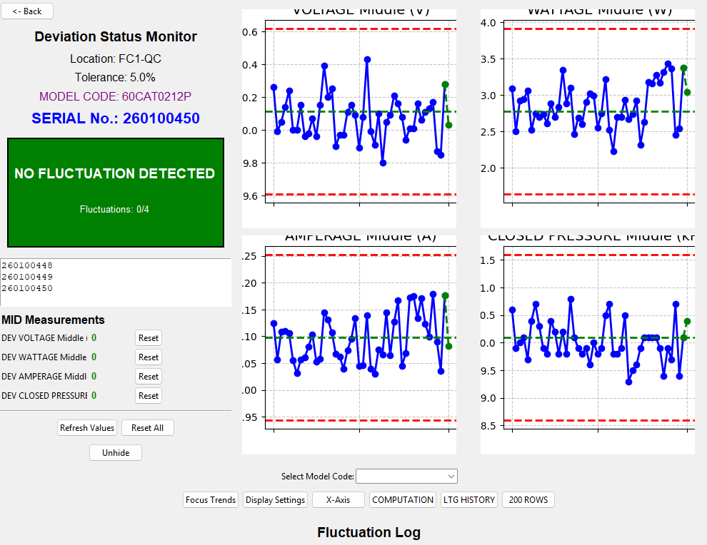
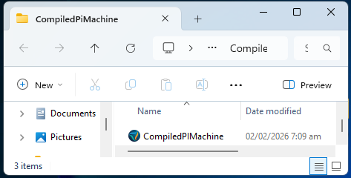
Deviation
    This program is a real-time statistical process control (SPC) monitoring + deviation/fluctuation detection system specifically built for a production inspection machine looking at parameters like Voltage, Wattage, Amperage and Closed pressure.

Slide 3
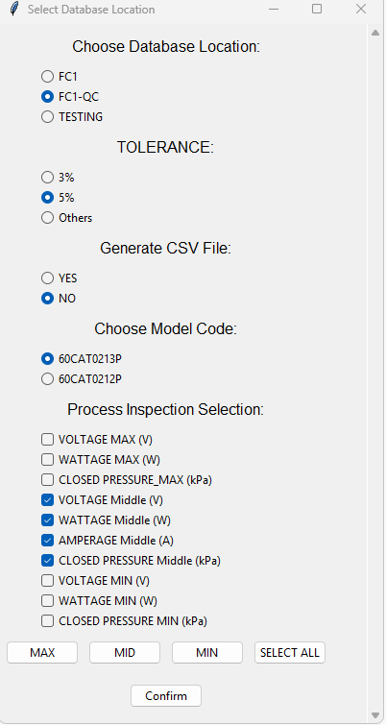
Deviation - Workflow
SELECT
MODEL CODE
GRAPHIC USER INTERFACE

Slide 4
Deviation - Workflow
START
Filter Pass and NG
Data
No
Fluctuation
Python read CSV data at PI Machine
PASS
Compute UCL and LCL
YOLO
BOXING
Fluctuated
NG
Repair
Repair

